Slide 1
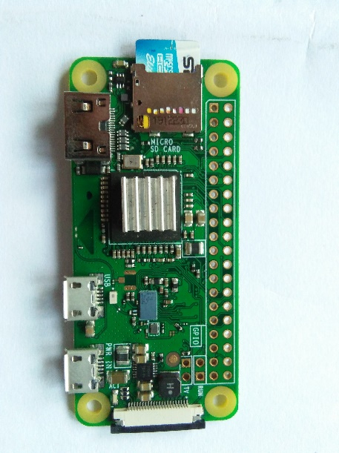
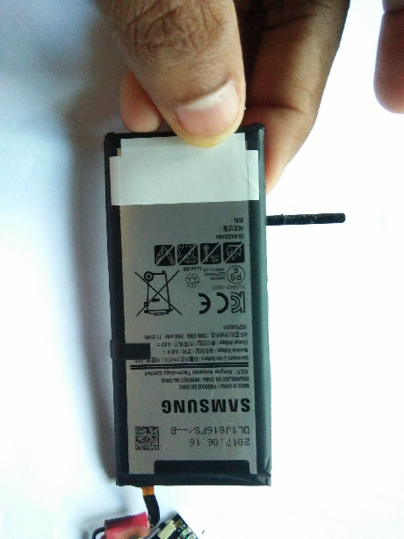
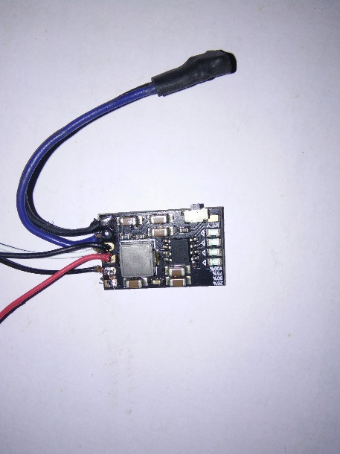
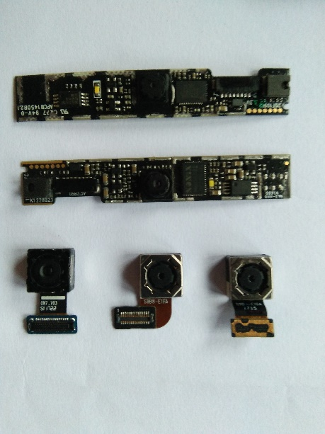
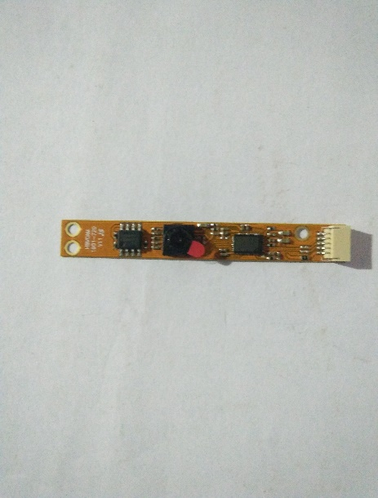
Short note making head band
HCI - project
T.D.K.Buddika
A.H.R.Lankapriya

Slide 2
Head band Short Note Making-Device Components
Raspberry Pi zero w
Tiny webcam camera 1MP USB webcam OV9726
Li-ion Battery 3.7v
MH-CD42 Power Module
Head Band

Slide 3
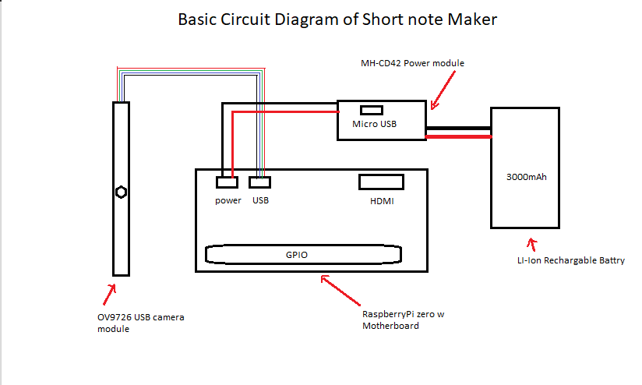

Slide 4
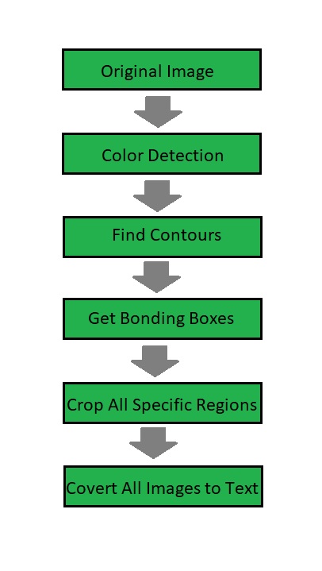
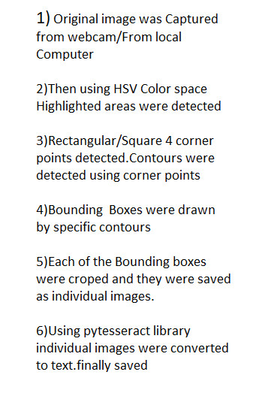
Procedure (programme)

Slide 5
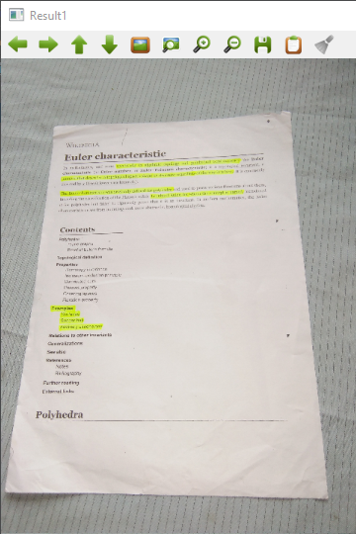
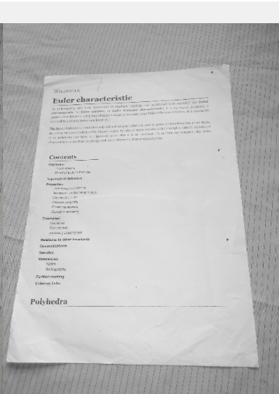
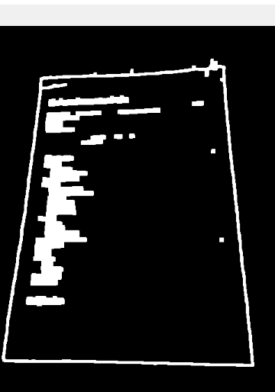
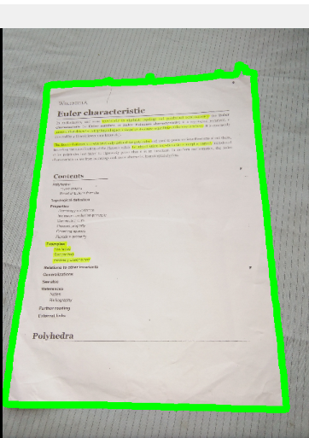
Webcam feed method
Original Image that captured from webcam feed
Converted image of Original Image to BGR to Gray
Canny edge detection of Gray scale image
By using Contour detection Biggest contour of document Detected

Slide 6
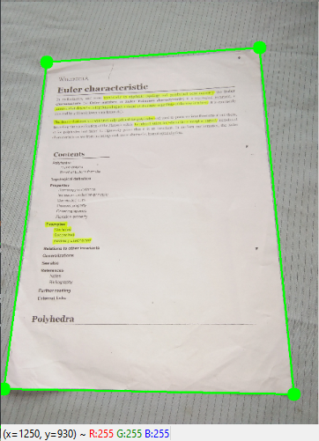
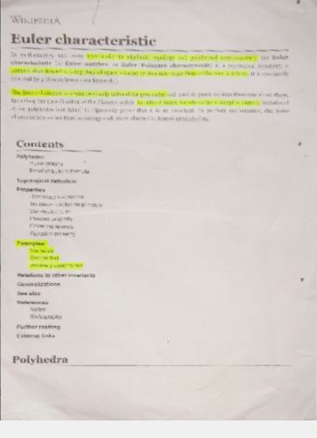
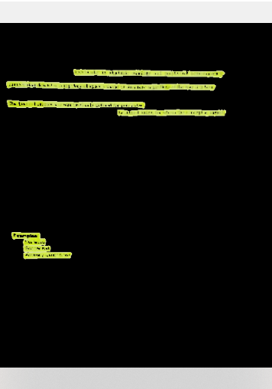
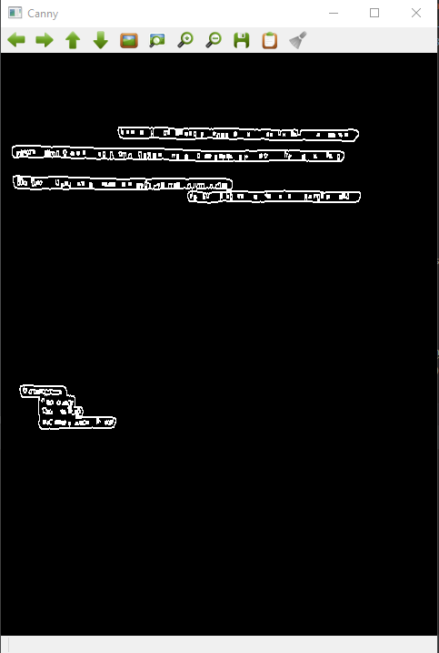
Document detection was successful
Background removed and warp perspective
projection of Original image
Highlighted areas were
Detected successfully
Use Canny edge detector to find contours

Slide 7
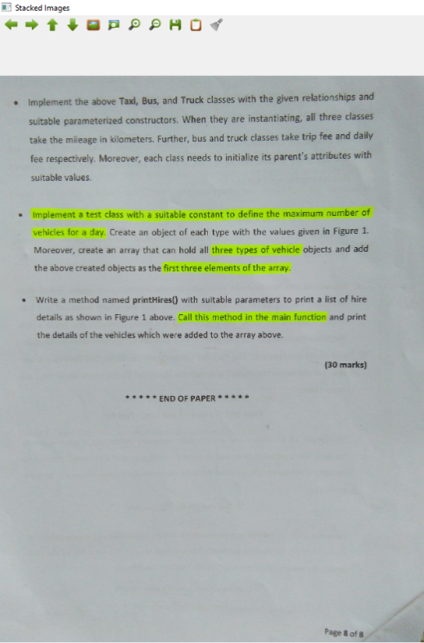
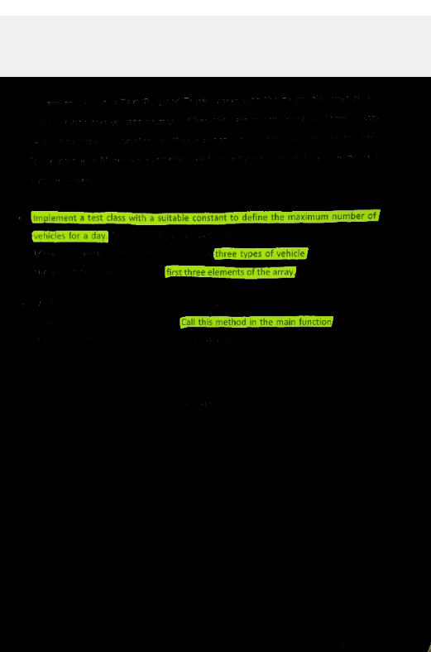
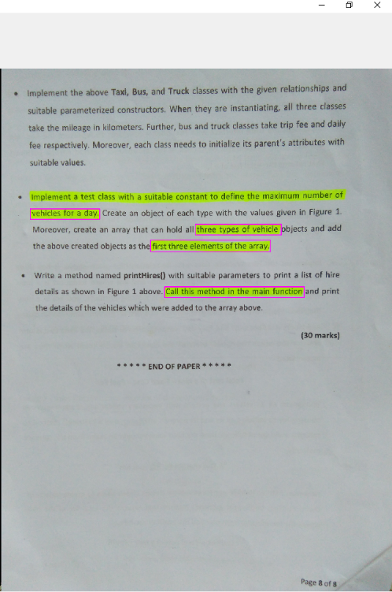
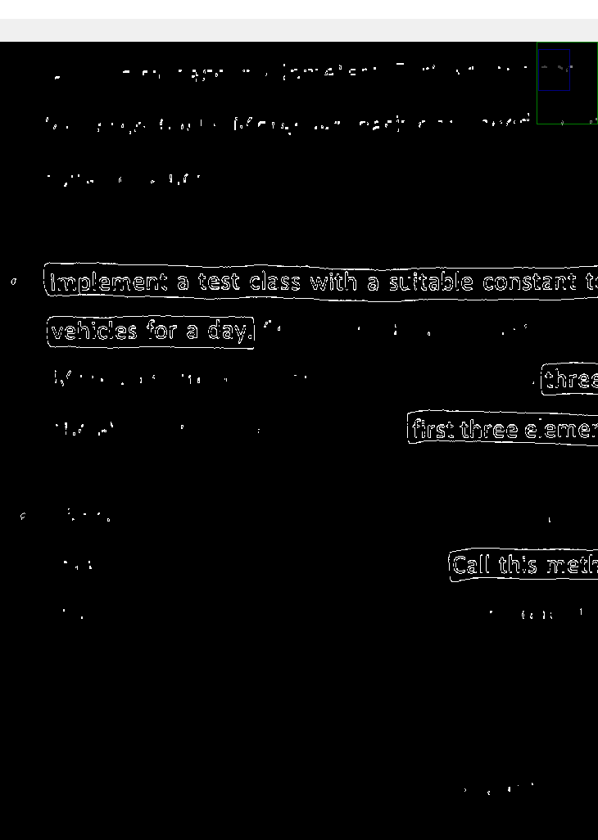
2. In Path Image Method
Original image read by path
HSV Color space to select Highlighted text selections
Highlighted text contours were detected
Canny edge detection

Slide 8
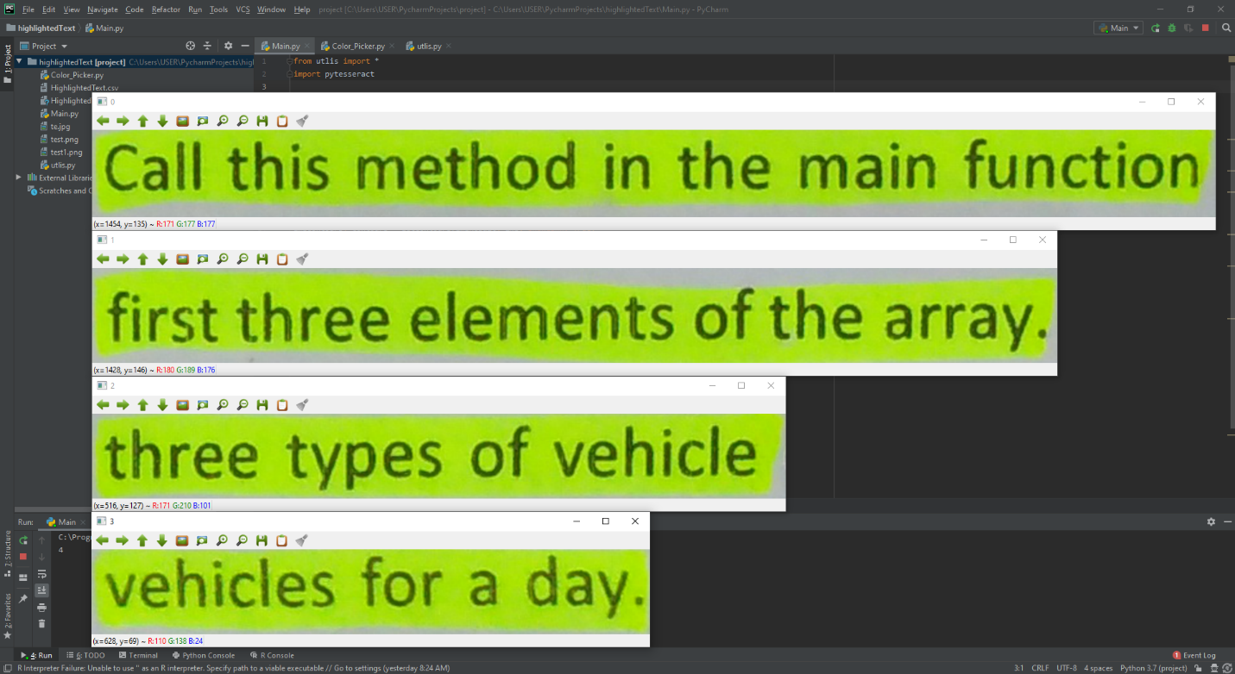
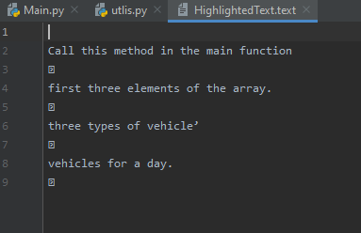
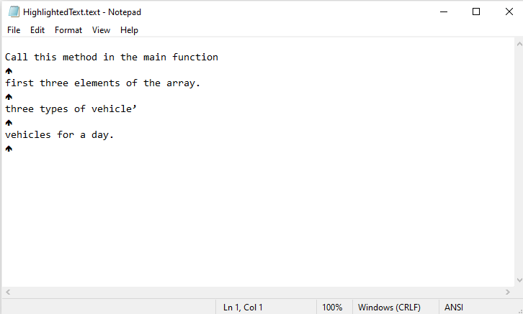
Text file created
Highlighted contours were extracted on by one
Then by using pytesseract library Selected contours were extracted

Slide 9
In this project; Device head band, it has tiny camera and it detects documents in real time. Raspberry pi is the main board which controls device. Programme detects document and also detects highlighted lines separately.
Firstly, we have to detect highlighted areas in document so we have read example image from on a local path/webcam and we have converted it to a HSV color space, then we have defined HSV values to 0-255 using track bars in defined mask to separate highlight areas.
Then in main program we have initialize HSV color space values and our detected document was filtered.
we convert it to HSV color space,
HSV stands for,
H: Hue-dominant color as perceived by an observer
S: Saturation-Amount of white light mixed with Hue
V: Value- Chromatic notion of intensity
HSV color space was used to select highlighted color separately. Yellow color was used in this project.
And the next part is to detect the highlighted areas in detected document, we were used OpenCV get Contours function to detect highlighted areas and also minimum area of threshold value was defined. All the contours detected and all contours were assigned to array of images.
Then we were used to extract text in images using pytesseract library. Then we were imported extracted texts to text/csv files.

Slide 10
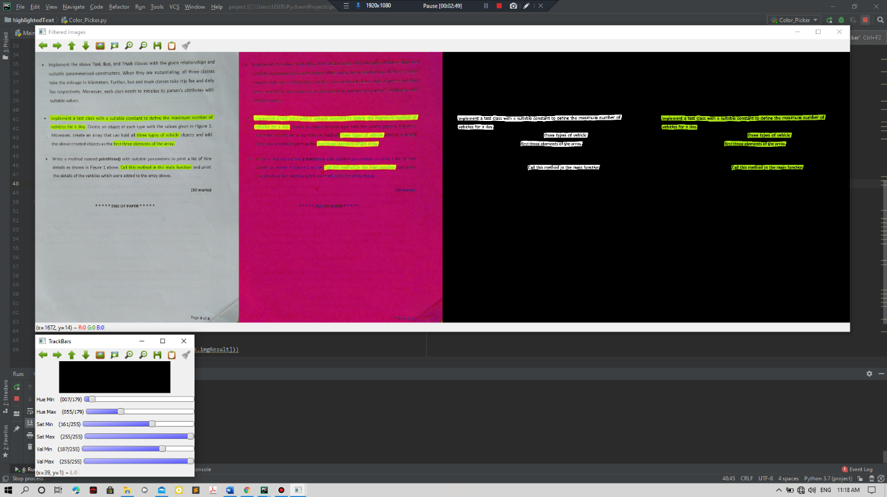
How programme works

Slide 11
THANK YOU

